Slide 1


Tower of Hanoi Solver
SM Nabil Ausaf Roll:01
Shahadat Hossen Shuvo Roll:17
Al Noman Robin Roll:19
Md. Yousuf Hossain Roll:31

Slide 2

Introduction
The Tower of Hanoi is a classic mathematical puzzle.
It consists of three pegs and a number of disks of different sizes.
Goal: Move all disks from the source peg to the destination peg following certain rules.
2

Slide 3




Rules of the Game
1
Only one disk can be moved at a time.
2
Each move consists of taking the top disk from one stack and placing it on top of another stack.
3
No disk may be placed on top of a smaller disk.
3

Slide 4

Mathematical Insight
Minimum number of moves: (2^n - 1).
For (n = 3) disks → (2^3 - 1 = 7) moves.
The growth is exponential: doubling the disks ≈ quadrupling the moves.
4

Slide 5

Algorithm (Recursive)
1
Move (n-1) disks from Source to Auxiliary peg.
2
Move the (n)th (largest) disk from Source to Destination peg.
3
Move (n-1) disks from Auxiliary peg to Destination peg.
5

Slide 6

Pseudocode
tower(n, s, a, d)
{
if (n == 1)
{
print "s → d"
return
}
tower(n-1, s, d, a)
print "s → d"
tower(n-1, a, s, d)
return
}
6

Slide 7

C Code Example
#include <stdio.h>
void tower(int n, char Source, char Auxilary, char Destination) {
if (n == 1) {
printf("Move Tower %c → Tower %c\n", Source, Destination);
return;
}
tower(n - 1, Source, Destination, Auxilary);
printf("Move Tower %c → Tower %c\n", Source, Destination);
tower(n - 1, Auxilary, Source, Destination);
}
int main() {
int n;
printf("Enter number of disks: ");
scanf("%d", &n);
tower(n, 'A', 'B', 'C');
return 0;
}
7

Slide 8








Steps to solve 3 disk Hanoi tower
Move Tower A → Tower C
Move Tower C → Tower B
Move Tower A → Tower B
Move Tower A → Tower C
Move Tower B → Tower A
Move Tower B → Tower C
Move Tower A → Tower C
8

Slide 9
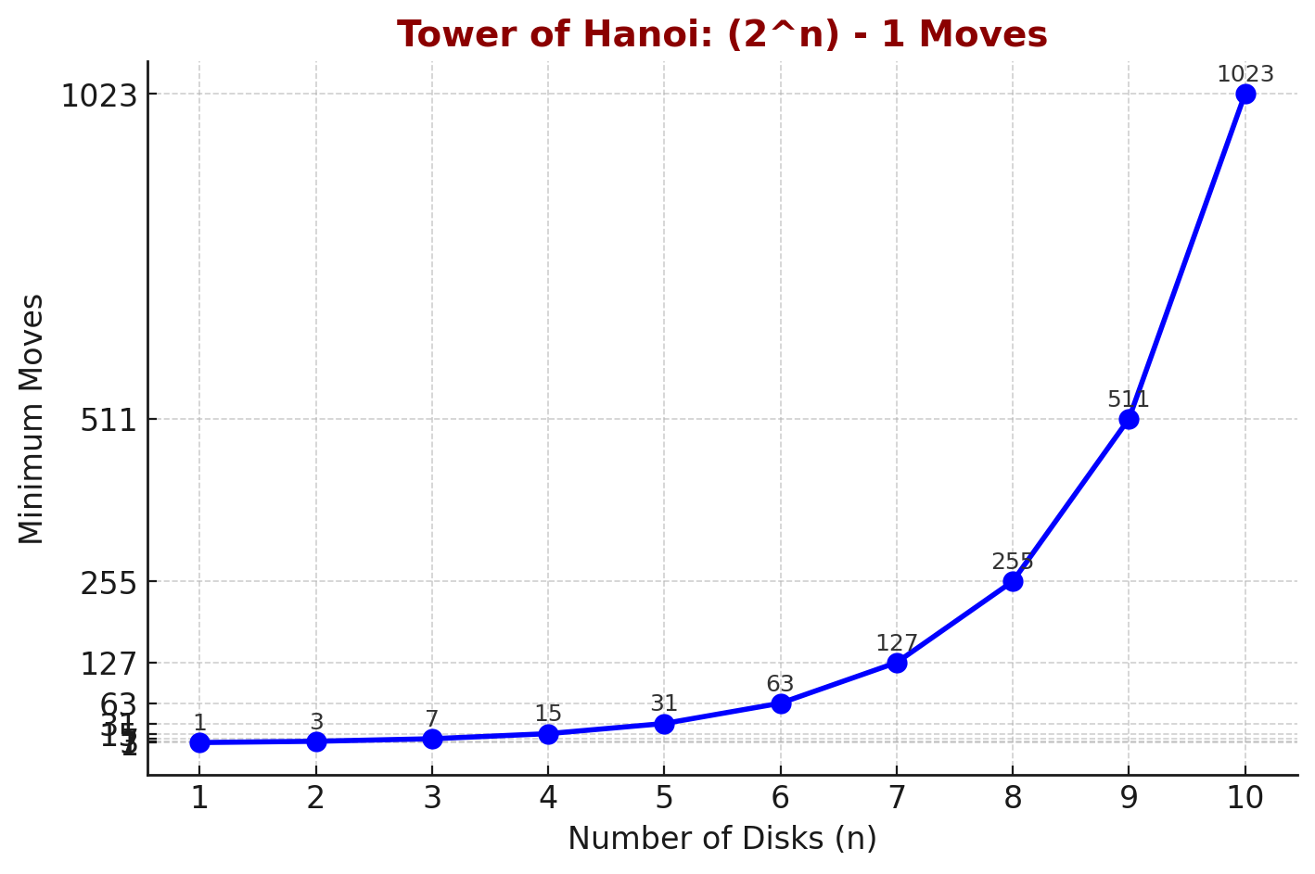
Time Complexity
Recurrence relation: (T(n) = 2T(n-1) + 1).
Solution: (T(n) = 2^n - 1).
Complexity: (O(2^n)).
9

Slide 10

Problem Nature
Tower of Hanoi is inherently a recursive problem.
To move n disks: First, move n-1 disks to the auxiliary rod. Then, move the largest disk to the target rod.
Finally, move the n-1 disks onto the largest disk.
Each step reduces the problem size by 1, making recursion a natural fit
10

Slide 11

Efficiency
The Tower of Hanoi is solved using a recursive algorithm that breaks the problem into
smaller subproblems.
The time complexity is O(2^n), which grows exponentially with the number of disks.
Each move involves transferring only one disk at a time and following the rules:
Only one disk can be moved in a single step.
A larger disk can never be placed on top of a smaller disk.
The recursive approach uses three pegs: source, auxiliary, and destination,
moving n−1n-1 disks to the auxiliary,
then moving the largest disk, and finally moving the n−1n-1 disks to the destination.
11

Slide 12

Conclusion
Tower of Hanoi is a classic recursion problem.
Simple rules lead to complex patterns.
Minimum moves grow exponentially (2^n - 1).
Great for learning problem-solving and algorithmic thinking
12

Slide 13

Thank You

